Slide 1
Docker

Slide 2
Why the buzz around Containers and Docker?
The software industry has changed
Before:
monolithic applications
long development cycles
single environment
slowly scaling up
Now:
decoupled services
fast, iterative improvements
multiple environments
quickly scaling out
3

Slide 3
Deployment becomes very complex
Many different stacks:
languages
frameworks
Databases
Many different targets:
individual development environments
pre-production, QA, staging...
production: on prem, cloud, hybrid
3

Slide 4
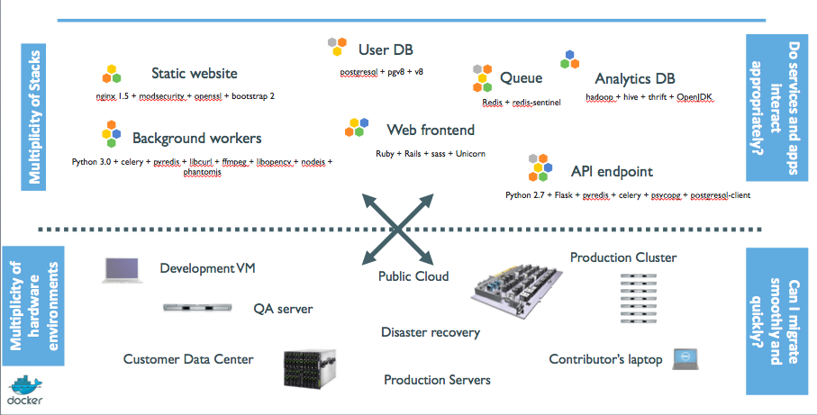
The deployment problem
3

Slide 5
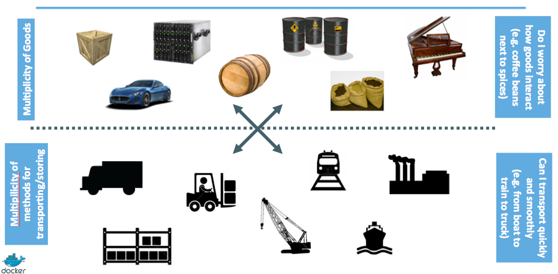
Analogy with the shipping industry
3

Slide 6
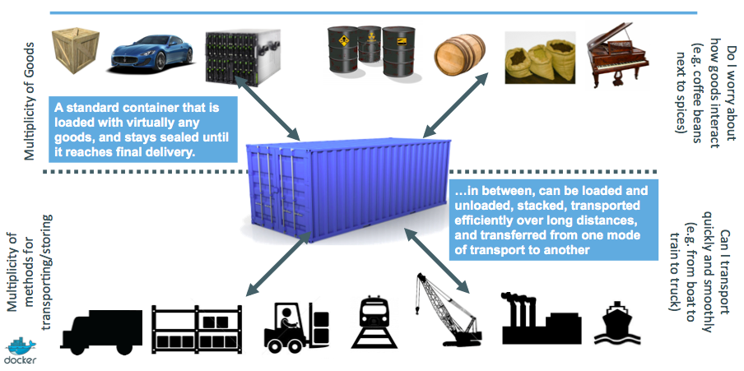
Intermodal shipping containers
3

Slide 7
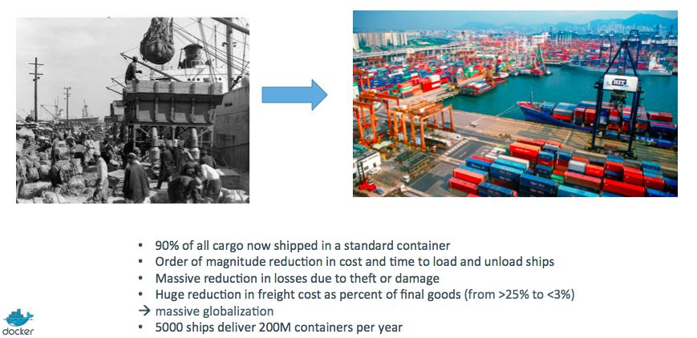
A new shipping ecosystem
3

Slide 8
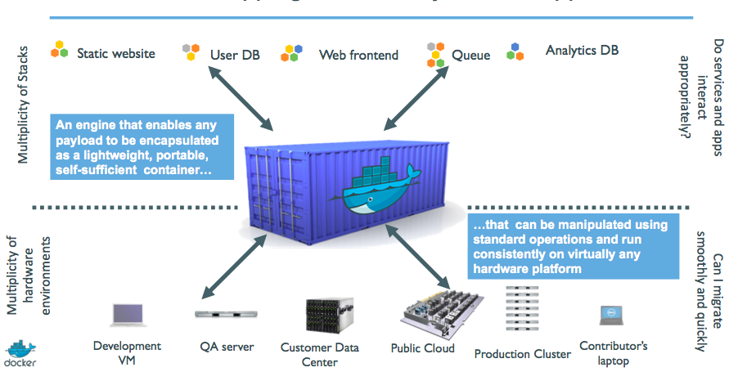
A shipping container system for applications
3

Slide 9
Results
Dev-to-prod reduced from 9 months to 15 minutes (ING)
Continuous integration job time reduced by more than 60% (BBC)
Deploy 100 times a day instead of once a week (GILT)
70% infrastructure consolidation (MetLife)
60% infrastructure consolidation (Intesa Sanpaolo)
14x application density; 60% of legacy datacenter migrated in 4 months (GE Appliances)
etc.
3

Slide 10


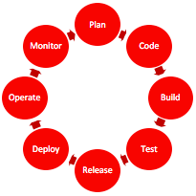
History and Multi-Dimensional Evolution of Computing
Development Process | Application Architecture | Deployment and Packaging | Application Infrastructure
Waterfall | Monolithic | Physical Server | Datacenter
Agile | N-Tier | Virtual Servers | Hosted
DevOps | Microservices | Containers | Cloud
Notes:
All of this is part of a transformation of technologies along a number of fronts, and is the basis for modern agile application development.

Slide 11
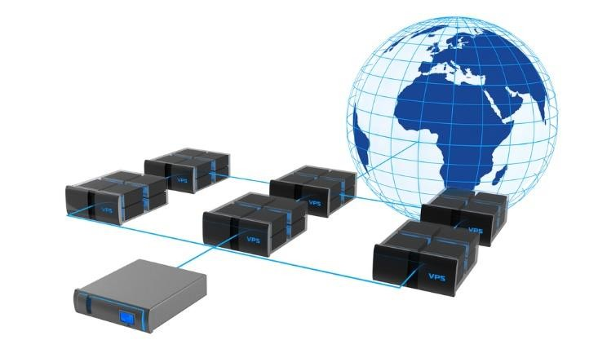
Virtualization
Virtualization means to create a virtual version of a device or resource, such as a storage device, server, network, an OS, hardware, etc. where the framework divides the resource into one or more execution environments.
→ Partitioning a hard drive is considered virtualization because one drive is partitioned to create two separate hard drives
→ Devices, applications and human users are able to interact with the virtual resource as if it were a real single logical resource
3

Slide 12
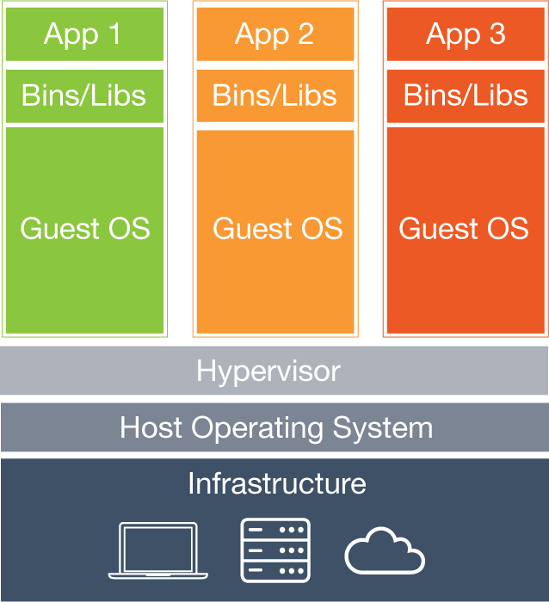
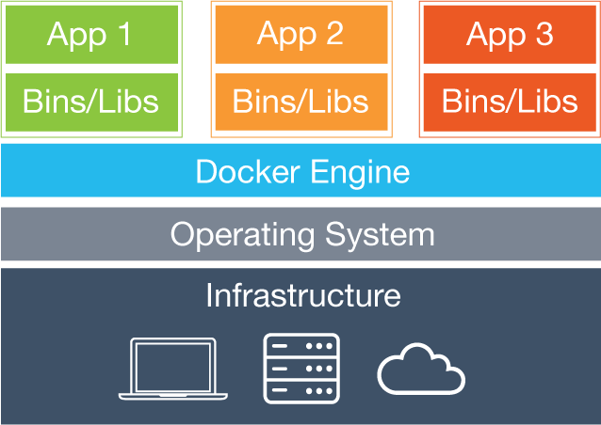
Virtual Machines vs. Containers - Architecture
Containers
VMs
Virtual Machines
Each virtual machine (VM) includes the app, the necessary binaries and libraries and an entire guest operating system
Containers
Containers include the app & all of its dependencies, but share the kernel with other containers.
Run as an isolated process in userspace on the host OS
Not tied to any specific infrastructure – containers run on any computer, infrastructure and cloud.
Notes:
Now, let's look at how a virtual machine (VM) is different from a container.
While containers may sound like a VM, the two are distinct technologies. With VMs each virtual machine includes the application, the necessary binaries and libraries and the entire guest operating system.
Whereas, Containers include the application, all of its dependencies, but share the kernel with other containers and are not tied to any specific infrastructure, other than having the Docker engine installed on its host – allowing containers to run on almost any computer, infrastructure and cloud.
Note - at this time, Windows and Linux containers require that they run on their respective kernel base, therefore, Windows containers cannot run on Linux hosts and vice versa.

Slide 13
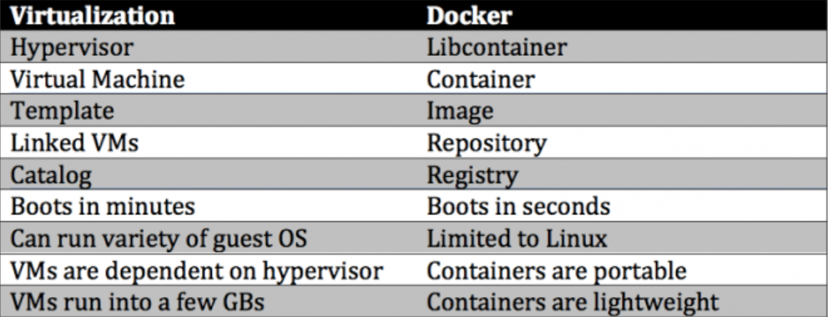
Virtual Machines vs. Containers – Key differences

Slide 14
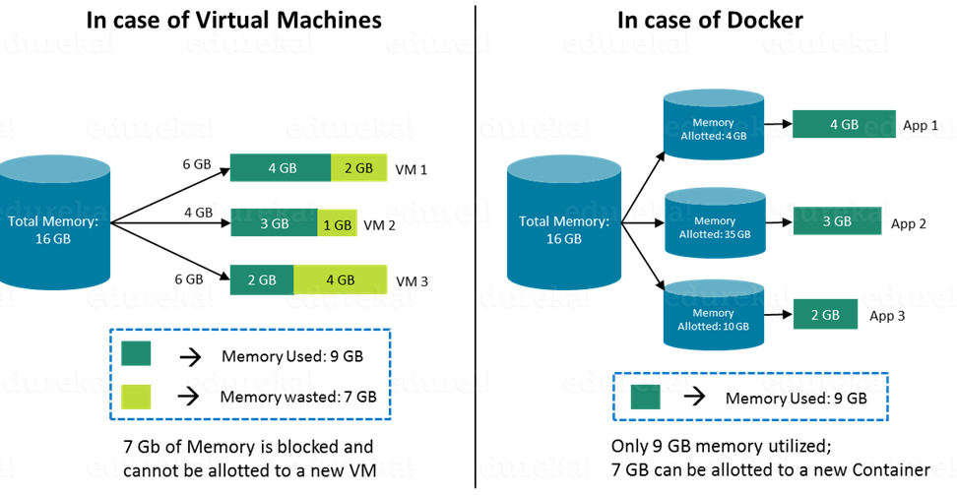
Virtual Machines vs. Containers - Size

Slide 15
What is Docker?
Docker is an Open platform for developers and sysadmins to build, ship and run distributed applications.
It can run on most Linux distributions, Windows and Mac OS running Docker Engine (Toolbox).
It is supported by most of cloud providers and provide a popular Dev/Test, CI & DevOps platform for many use cases.
Notes:
Intro to Basic Container Concepts
A container is a runtime instance of a Docker image.
https://docs.docker.com/engine/reference/glossary/#/container
Docker is the company and containerization technology.
https://docs.docker.com/engine/reference/glossary/#/docker

Slide 16
First Public release of Docker
March 2013, PyCon, Santa Clara:
"Docker" is shown to a public audience for the first time.
It is released with an open source license.
Very positive reactions and feedback!
The dotCloud team progressively shifts to Docker development.
The same year, dotCloud changes name to Docker.

Slide 17
Basic Architecture

Slide 18
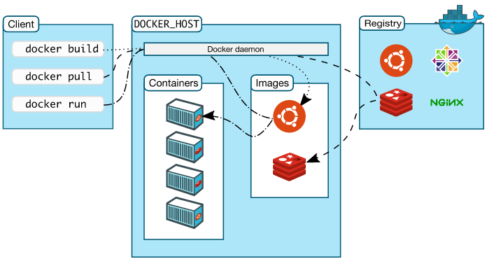
Docker Architecture
Docker Engine – Docker Daemon,
REST API, CLI.
Docker client – Command Line Interface (CLI) for interfacing with the Docker
Image – Hierarchies of files built from a Dockerfile, the file used as input to the docker build command
Container – Running instance of an Image using the docker run command
Dockerfile – Text file of Docker instructions used to assemble a Docker Image
Docker Hub (Registry) – Image repository
Notes:
Jumping back a bit, there is a new nomenclature that Docker introduces, here are terms that you will need to be familiar with.
Each of these Docker technologies will be explored in this HOL. It's important to note that this core technology is open source. There are other technologies in the greater ecosystem, that could be open source, or licensed or even a hybrid, with a paid support option.

Slide 19

Docker Engine
Docker Engine is a client-server application with these major components:
A server which is a type of long-running program called a daemon process (the dockerd command).
A REST API which specifies interfaces that programs can use to talk to the daemon and instruct it what to do.
A command line interface (CLI) client (the docker command).
Notes:
The Docker Engine is THE core piece of technology that allows you to run containers. In order for a container to run on any Linux host, at a minimum, the Docker Engine needs to be installed. Then the container can run on any Linux host where Docker Engine is installed, providing the benefit of portability, without doing any application specific configuration changes on each host.

Slide 20
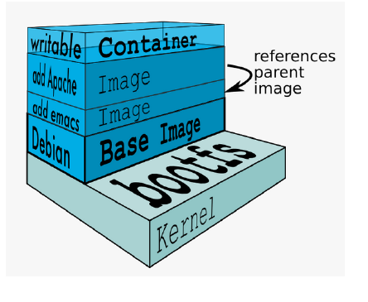
Docker Images
Image = files + metadata
These files form the root filesystem of our container.
The metadata can indicate a number of things, e.g.:
the author of the image
the command to execute in the container when starting it
environment variables to be set
etc.
Images are made of layers, conceptually stacked on top of each other.
Each layer can add, change, and remove files and/or metadata.
Images can share layers to optimize disk usage, transfer times, and memory use.
Source: Docker docs and https://docs.docker.com/glossary/
Notes:
Docker images are a collection of files, which have everything needed to run the software application inside the container. However, they are ephemeral, meaning that any data that is written inside the container, while it is running, will not be retained.
If the container is stopped and restarted from its image, the container will run exactly the same as the first time, absent of any changes made during the last run cycle. Changes to the container either have to be made during the image creation process, using the Dockerfile that become part of the image, or data can be retained by mounting a persistent storage volume, from inside the container to the outside. This will be explored further in the HOL exercises below.

Slide 21
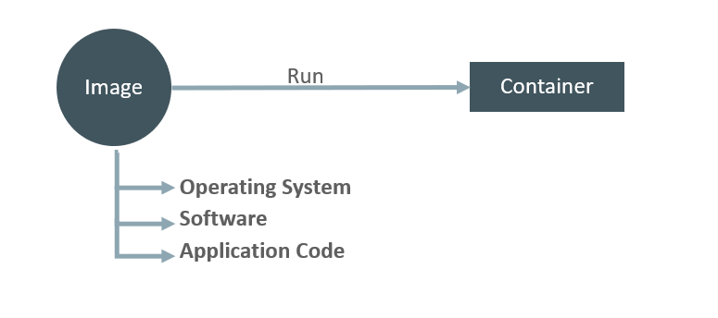
Docker Image vs Container
An image is a read-only filesystem.
A container is an encapsulated set of processes.
Running in a read-write copy of that file system.
docker run command starts a container from a given image.

Slide 22
Analogy with Object oriented programming
Images are conceptually similar to classes.
Layers are conceptually similar to inheritance.
Containers are conceptually similar to instances.

Slide 23
How to change an Image
If an image is read-only, how do we change it?
We create a new container from that image.
Then we make changes to that container.
When we are satisfied with those changes, we transform them into a new layer.
A new image is created by stacking the new layer on top of the old image.

Slide 24
Creating images
docker build
Performs a repeatable build sequence.
This is the preferred method!
docker commit
Saves all the changes made to a container into a new layer.
Creates a new image (effectively a copy of the container).

Slide 25
Image namespaces
There are three namespaces:
Root namespace for Official images
e.g. ubuntu, busybox ...
User namespace for User (and organizations) images
e.g. jpetazzo/clock
Self-hosted namespace for Self-hosted images
e.g. registry.example.com:5000/my-private/image
Let's explain each of them.

Slide 26
Root namespace
The root namespace is for official images.
They are gated by Docker Inc.
They are generally authored and maintained by third parties.
Those images include:
Small images like busybox.
Images to be used as bases for your builds like ubuntu, fedora...
Ready-to-use components and services, like redis, postgresql...
Over 150 such images are there at this point!

Slide 27
User namespace
The user namespace holds images for Docker Hub users and organizations.
For example:
jpetazzo/clock
The Docker Hub user is:
Jpetazzo
The image name is:
clock

Slide 28
Self-hosted namespace
This namespace holds images which are not hosted on Docker Hub, but on third party registries.
They contain the hostname (or IP address), and optionally the port, of the registry server.
For example:
localhost:5000/wordpress
localhost:5000 - host and port of the registry
wordpress - name of the image

Slide 29
Store and manage images
Images can be stored:
On your Docker host.
In a Docker registry.
You can use the Docker client to download or upload images.
docker pull - to download image
docker push - to upload image

Slide 30
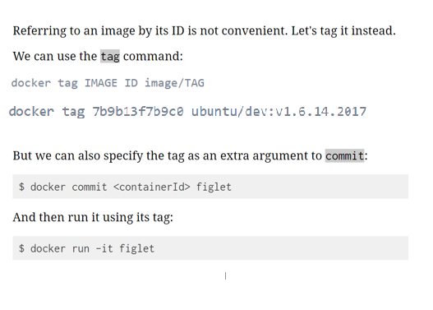
Tag images
Images can have tags.
Tags define image versions or variants.
docker pull ubuntu is equivalent to docker pull ubuntu:latest
The :latest tag is generally updated often.

Slide 31
When to (not to) use tags
Don't specify tags:
When doing rapid testing and prototyping.
When experimenting.
When you want the latest version.
Do specify tags:
When going to production.
To ensure that the same version will be used everywhere.
To ensure repeatability later.

Slide 32
Lab1
Docker Install & basic commands

Slide 33
Docker Install
Installation process for Docker on Ubuntu 16.04 machine.
Install required Packages
sudo apt-get install curl apt-transport-https ca-certificates software-properties-common
2. Setup Docker repository
curl -fsSL https://download.docker.com/linux/ubuntu/gpg | sudo apt-key add -
sudo add-apt-repository "deb [arch=amd64] https://download.docker.com/linux/ubuntu $(lsb_release -cs) stable“
3. Install Docker On Ubuntu
sudo apt-get update
sudo apt-get install -y docker-ce
sudo systemctl status docker

Slide 34
Docker CLI – Common / useful commands
docker pull : pull images/volumes from Docker Registry.
docker images : list all images on the local volume.
docker run : run docker image.
docker ps : list running docker containers (analogous to ps).
docker ps –a : list all containers including not running.
docker logs : show log data for a running or stopped container.
docker rm : remove/delete a container | docker rmi : remove/delete an image.
docker tag : name a docker image.
docker build : build docker image from Dockerfile.
docker login : login to registry.
docker push : push images/volumes to Docker Registry.
docker inspect : return container run time configuration parameter metadata.

Slide 35
Hello World
In your Docker environment, just run the following command:
$ docker run busybox echo hello world
hello world
(If your Docker install is brand new, you will also see a few extra lines, corresponding to the download of the busybox image.)

Slide 36
A more useful container
This is a brand new container.
It runs a bare-bones, no-frills ubuntu system.
-it is shorthand for -i -t.
-i tells Docker to connect us to the container's stdin. (interactive mode)
-t tells Docker that we want a pseudo-terminal. (tty)

Slide 37
A more useful container
Try to run figlet in our container.
Alright, we need to install it.

Slide 38
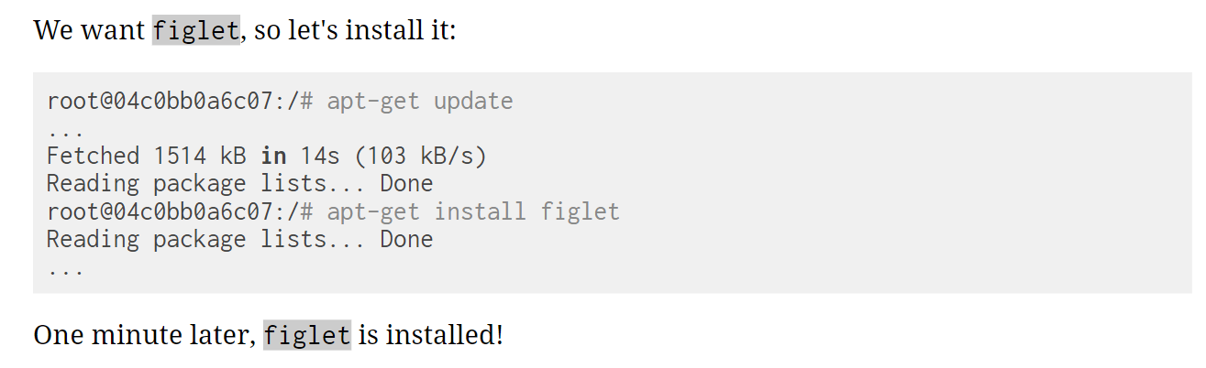
Do something in our container

Slide 39
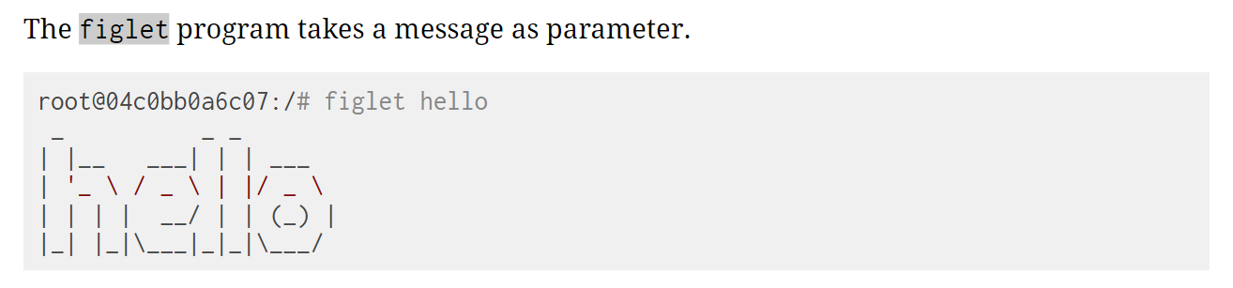
Try to run installed program “figlet”

Slide 40
Comparing the container and the host
Exit the container by logging out of the shell, with ^D or exit.
Now try to run figlet. Does that work?
(It shouldn't; except if, by coincidence, you are running on a machine where figlet was installed before.)

Slide 41
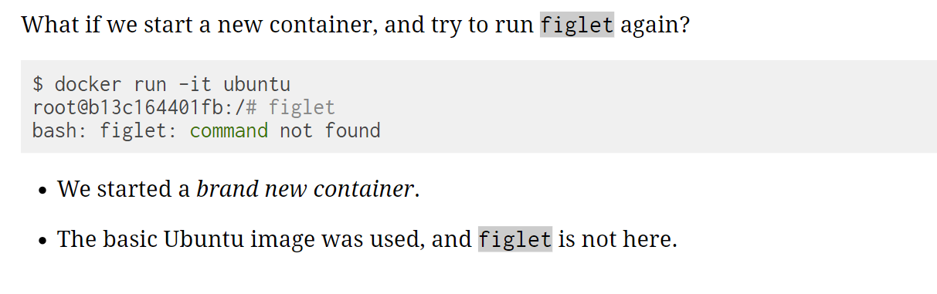
Starting another container

Slide 42
Where is my container
Can we reuse that container that we took time to customize?
We can, but that's not the default workflow with Docker.
What's the default workflow, then?
Always start with a fresh container. If we need something installed in our container, build a custom image.
That seems complicated!
We'll see that it's actually pretty easy!
And what's the point?
This puts a strong emphasis on automation and repeatability. Let's see why ...

Slide 43
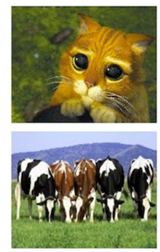
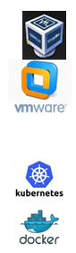
Pets Vs Cattle
In the "pets vs. cattle" metaphor, there are two kinds of servers.
Pets:
have distinctive names and unique configurations
when they have an outage, we do everything we can to fix them
Examples are : Oracle VirtualBox and VMWare
Cattle:
have generic names (e.g. with numbers) and generic configuration
configuration is enforced by configuration management, golden images ...
when they have an outage, we can replace them immediately with a new server
Examples are : Docker and Kubernetes
What's the connection with Docker and containers?

Slide 44
Local development environments
When we use local VMs (with e.g. VirtualBox or VMware), our workflow looks like this:
create VM from base template (Ubuntu, CentOS...)
install packages, set up environment
work on project
when done, shut down VM
next time we need to work on project, restart VM as we left it
if we need to tweak the environment, we do it live
Over time, the VM configuration evolves, diverges.
We don't have a clean, reliable, deterministic way to provision that environment.

Slide 45
Local development with Docker
With Docker, the workflow looks like this:
create container image with our dev environment
run container with that image
work on project
when done, shut down container
next time we need to work on project, start a new container
if we need to tweak the environment, we create a new image
We have a clear definition of our environment, and can share it reliably with others.

Slide 46
Background containers

Slide 47
Objectives
Our first containers were interactive.
We will now see how to:
Run a non-interactive container.
Run a container in the background.
List running containers.
Check the logs of a container.
Stop a container.
List stopped containers.

Slide 48
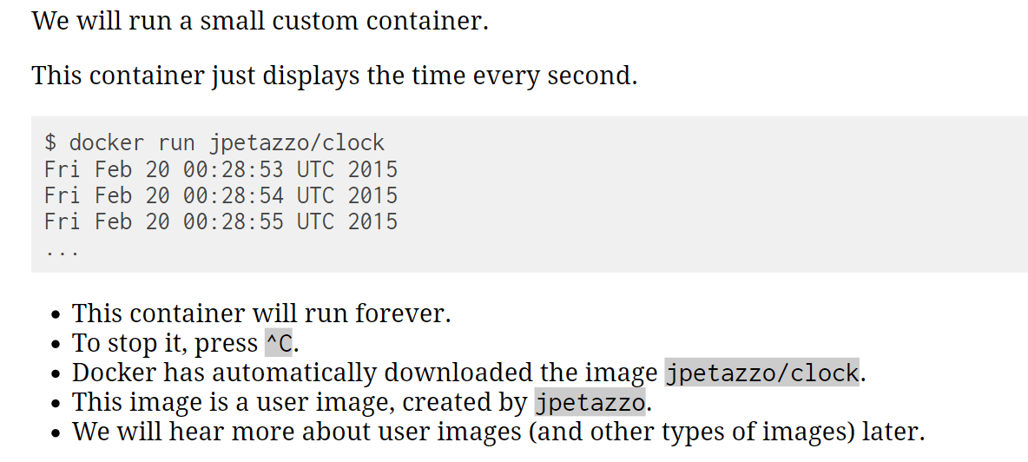
A non-interactive container

Slide 49
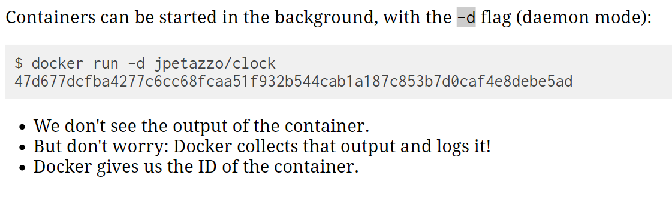
Run a container in the background

Slide 50
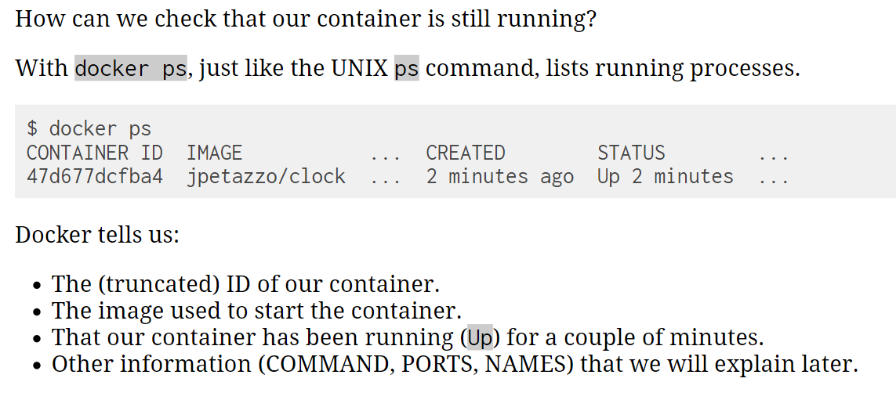
List running containers

Slide 51
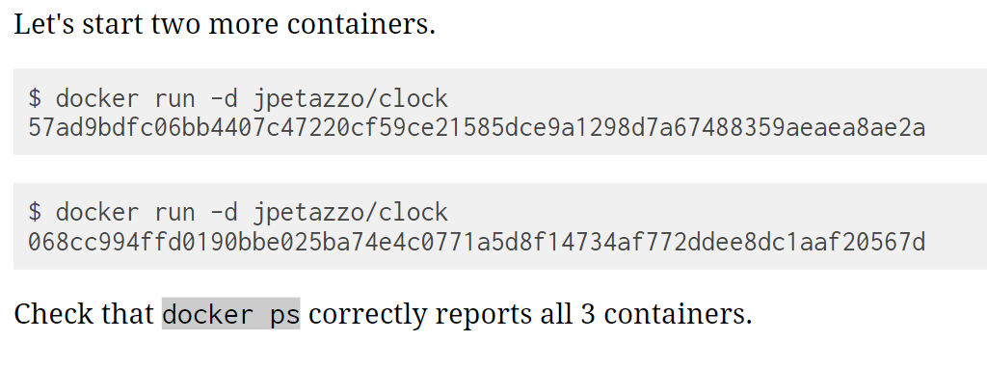
Starting more containers

Slide 52
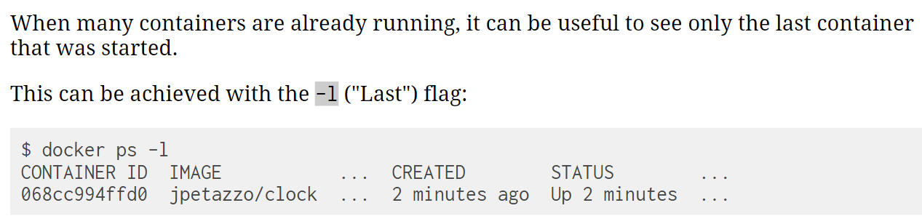
Viewing only the last container started

Slide 53
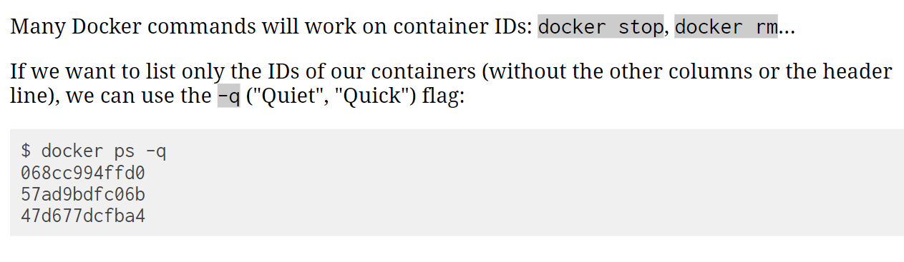
Viewing only the IDs of the containers

Slide 54
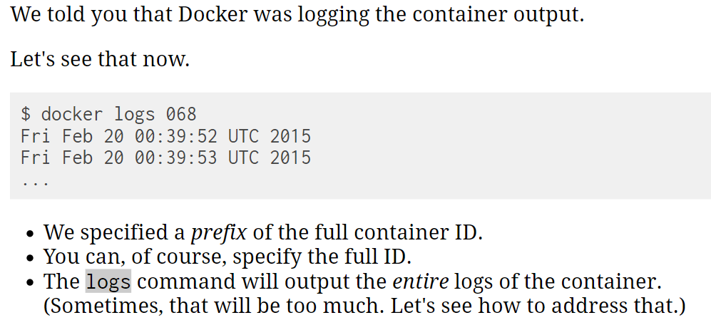
View the logs of a container

Slide 55
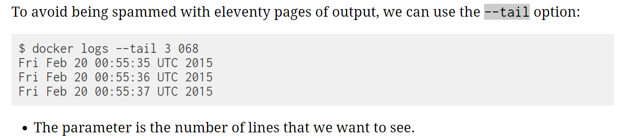
View only the tail of the logs of a container

Slide 56
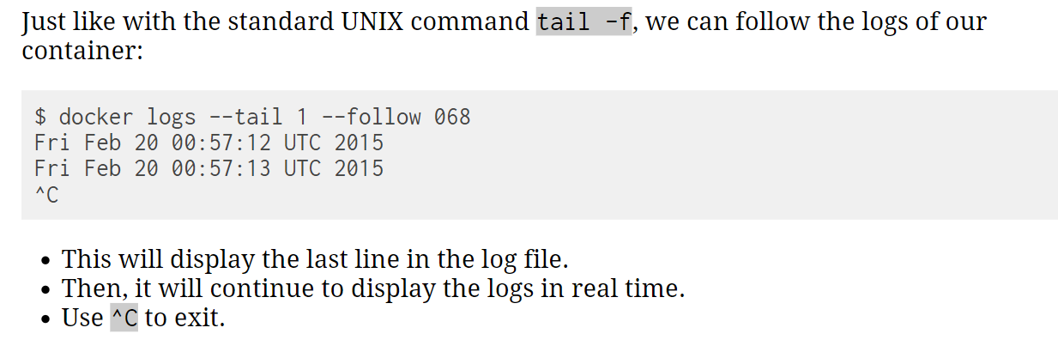
Follow the logs in real time

Slide 57
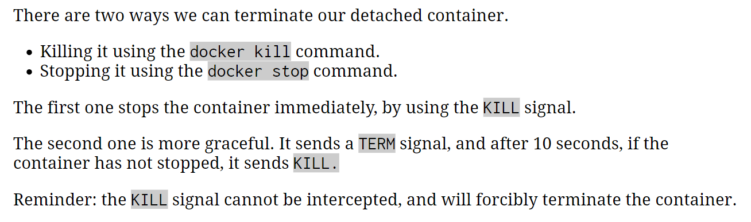
How to stop our containers

Slide 58
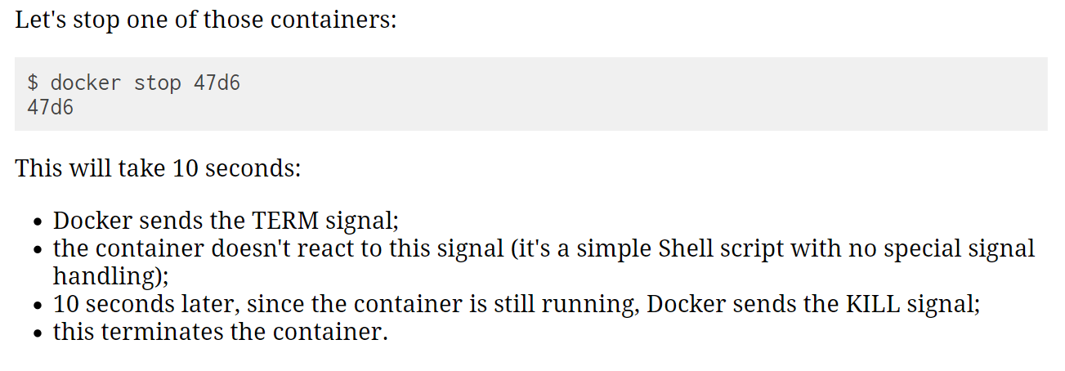
stop container using stop

Slide 59
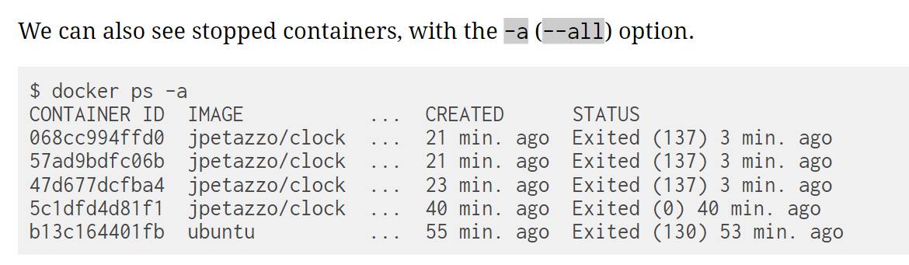
List stopped containers

Slide 60
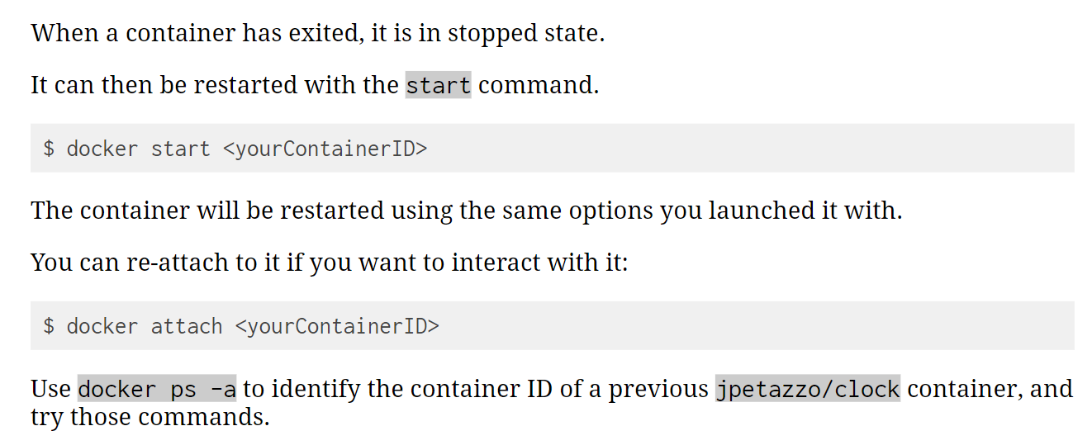
Restarting a container

Slide 61
Some more options to run a container
docker run [OPTIONS] IMAGE [COMMAND] [ARG...]
Examples:
docker run hello-world # install and run hello-world (foreground mode by default)
docker run -it ubuntu /bin/bash # run ubuntu container and log into it.
docker run -d -p 9090:80 -t <image id> # -d : detached mode
# -p : port forwarding 9090 -> host
80 -> container
docker exec -it <container id> /bin/bash #login to running container

Slide 62
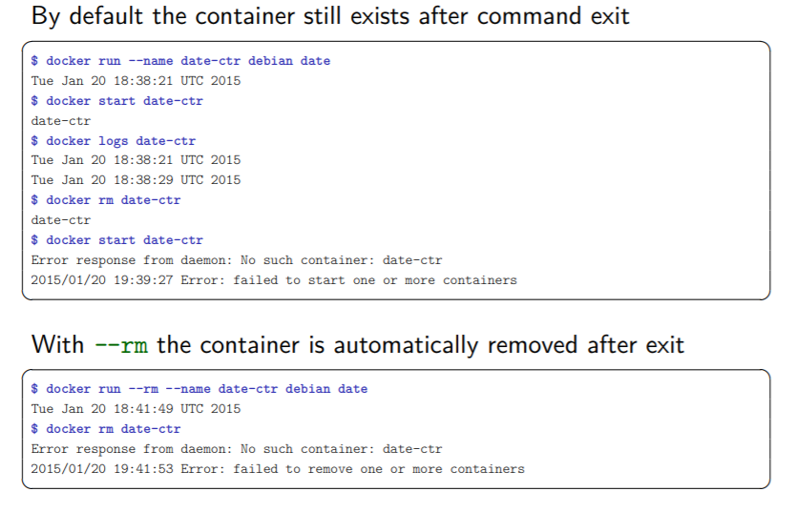
auto remove container

Slide 63
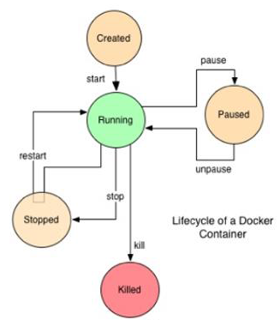
Docker Container Lifecycle
Conception
BUILD an Image from a Dockerfile
Birth
RUN (create+start) a container
Reproduction
COMMIT (persist) a container to a new image
RUN a new container from an image
Sleep
KILL a running container
Wake
START a stopped container
Death
RM (delete) a stopped container
Extinction
RMI a container image (delete image)

Slide 64
Build Docker Images - Dockerfile

Slide 65
Docker Flow
DockerFile
Image
Run
Container
Build

Slide 66
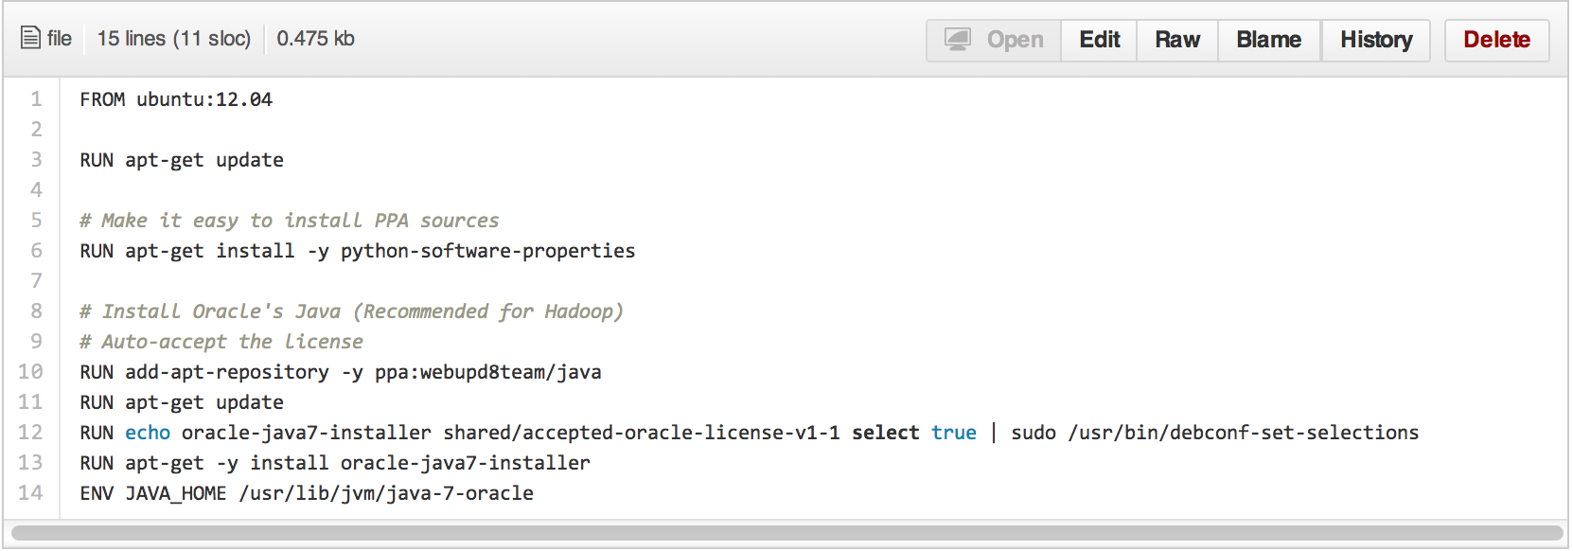
Dockerfile
• Like a Makefile (shell script)
• Extends from a Base Image
• Results in a new Docker Image
A Docker file lists the steps needed to build an images
• docker build command is used to run a Docker file

Slide 67
Writing our first Dockerfile
Our Dockerfile must be in a new, empty directory.
Create a directory to hold our Dockerfile.
$ mkdir MyDockerFile
Create a Dockerfile inside this directory.
$ cd MyDockerFile
$ vi Dockerfile

Slide 68
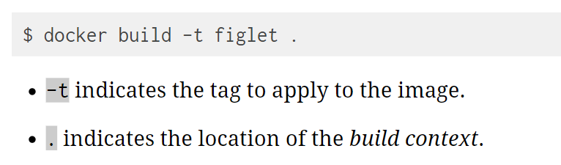
Building Dockerfile

Slide 69
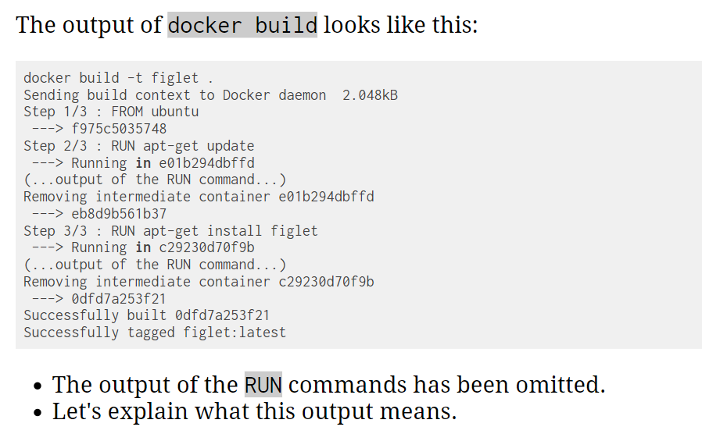
Dockerfile build output

Slide 70
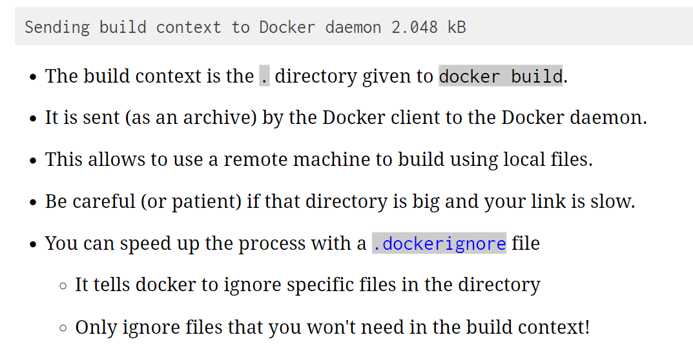
Dockerfile build output – sending build context to Docker Daemon

Slide 71
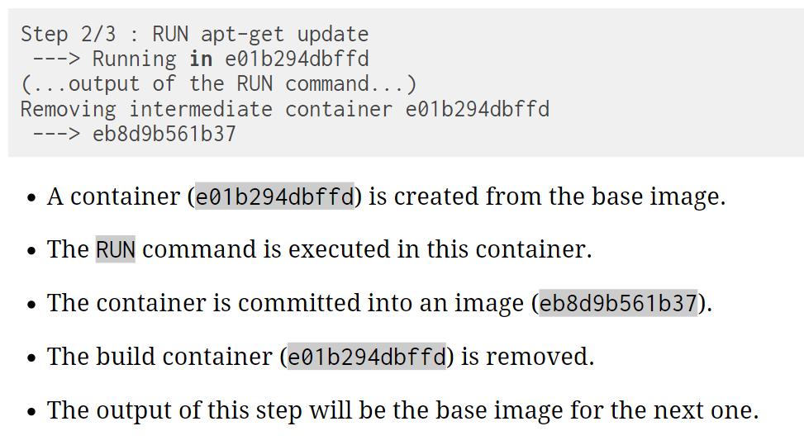
Dockerfile build output – execution steps

Slide 72
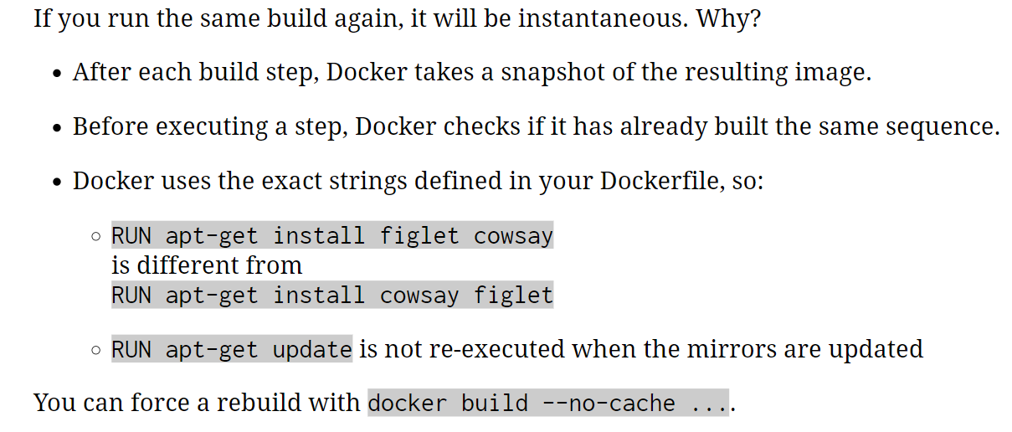
The cashing system

Slide 73
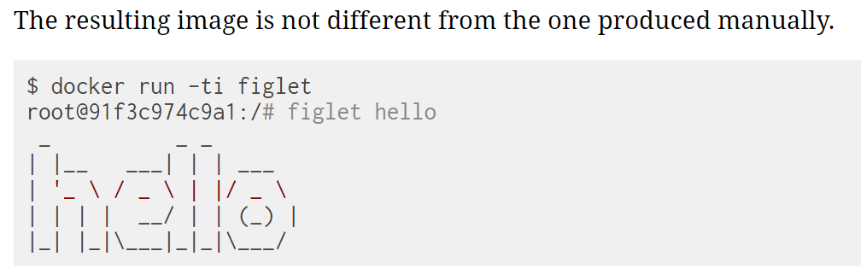
Running the image

Slide 74
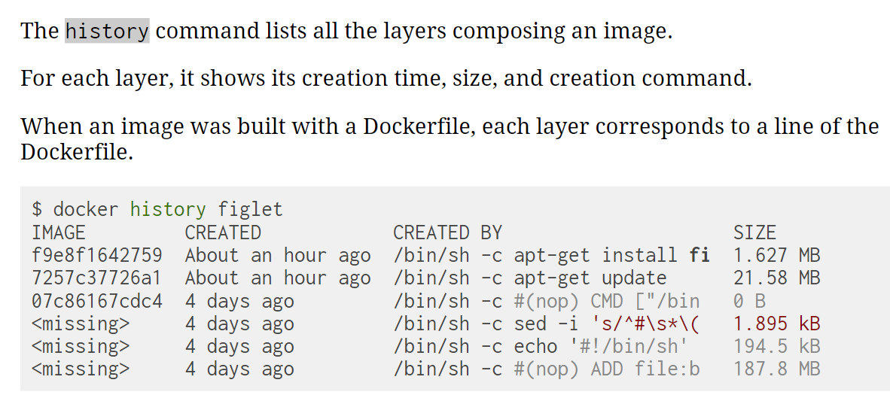
Viewing image history

Slide 75
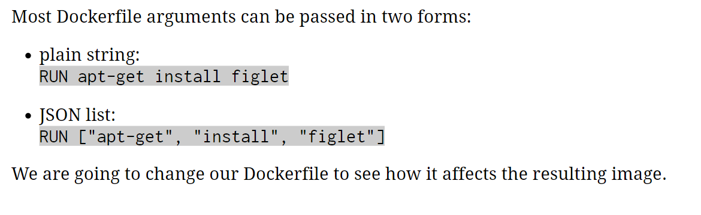
Introducing JSON syntax

Slide 76
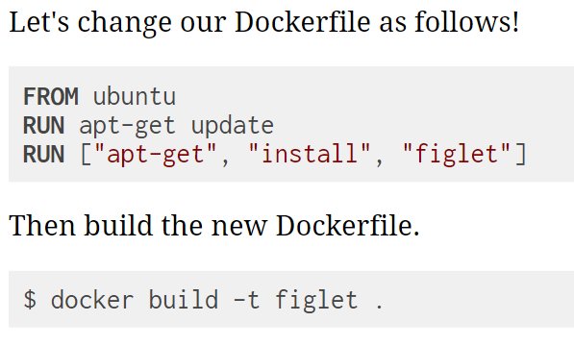
Using JSON syntax in Dockerfile

Slide 77
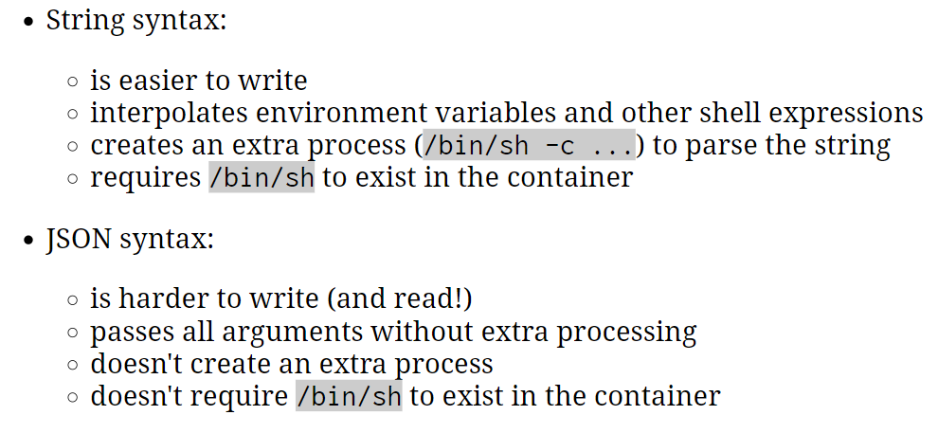
When to use JSON syntax and string syntax

Slide 78
Dockerfile – CMD and ENTRYPOINT
These commands allow us to set the default command to run in a container.

Slide 79
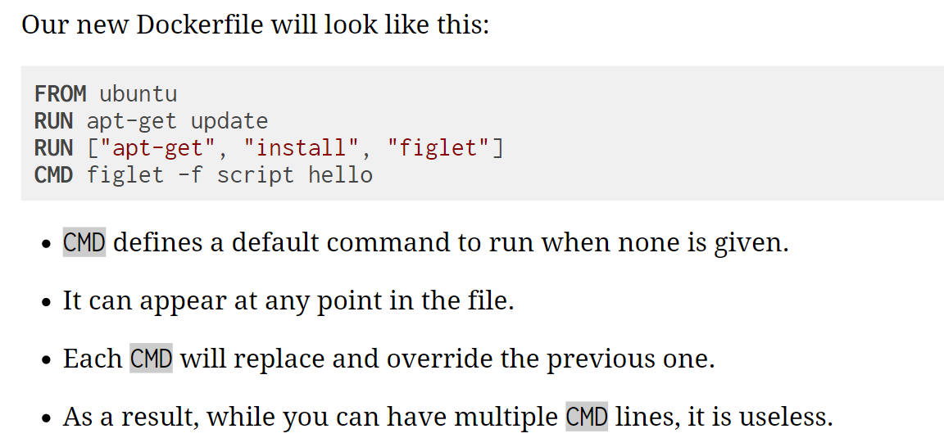
Dockerfile with CMD

Slide 80
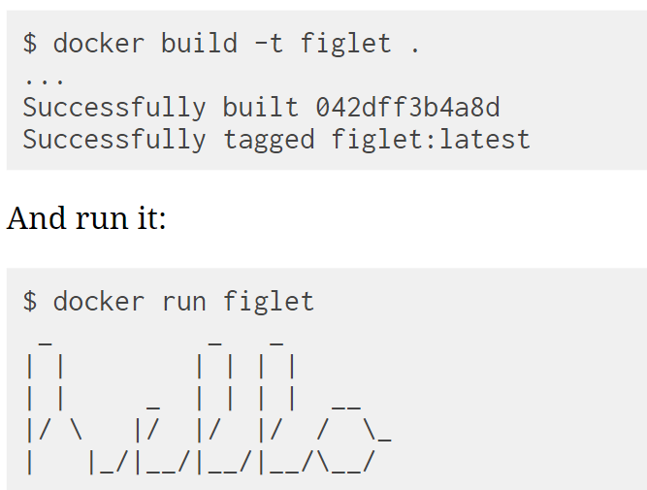
Build and test our image

Slide 81
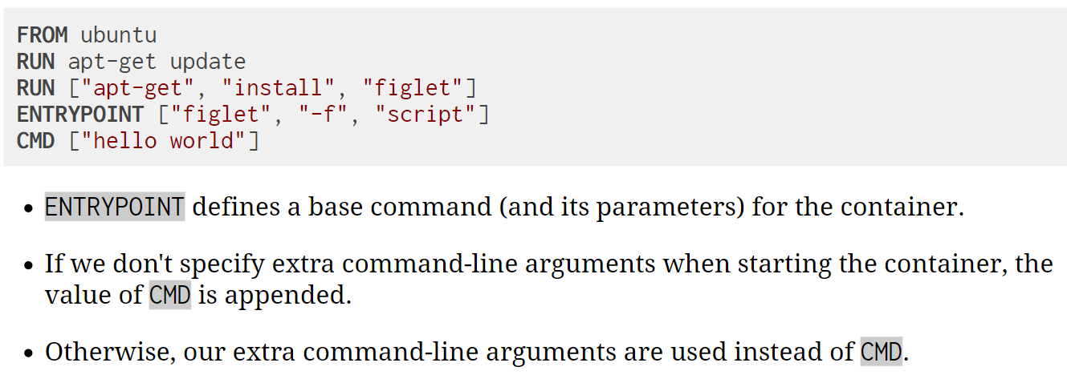
Dockerfile with CMD and ENTRYPOINT

Slide 82
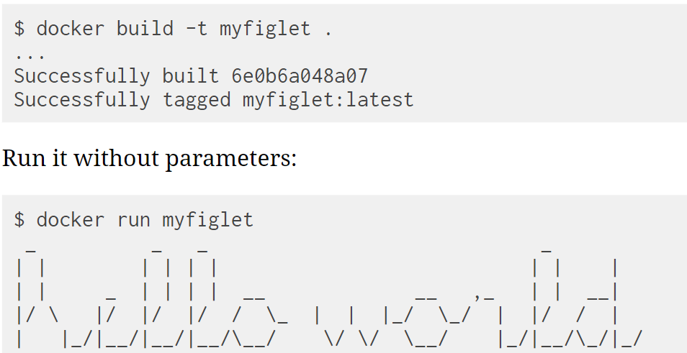

Build and test our image

Slide 83

Overriding ENTRYPOINT

Slide 84
Lab2
Setup website using Nginx
(refer github for code : static-site)

Slide 85
Containerizing an application using dockerfile
Example Static Site Dockerfile
Docker build image CLI example
FROM nginx
COPY wrapper.sh /
COPY html /usr/share/nginx/html
RUN chmod +x wrapper.sh
ENTRYPOINT ["/wrapper.sh"]
$ docker build -t static-site:1.0 .
NOTE: The “.” references Dockerfile in local directory
docker run -t -d -p 8181:80 static-site:1.0
docker exec -it <container id> /bin/bash
Oracle Confidential – Restricted
Notes:
FROM nginx
RUN echo “***” > /usr/share/nginx/html/index.html

Slide 86
Use Cases

Slide 87
Excellent Use Cases for Containers
Ready to Run Application Stacks
Excellent for Dev/Test setups
Deployment in Seconds, not Hours/Days
Start Up, Tear Down Quickly
Front-End App Servers
Highly horizontally scalable
Fast A/B, Rolling Deployments
Traditional Technologies - MW/Backend
New App Dev & Microservices
Refactor all or part of legacy app
Containers are great for Microservices
Server Density
Containers can use dynamic ports
Run many of the same app on a server
instead of one per VM
One-Time Run Jobs and Analytics
Run the Job / Analysis and quit

Slide 88

Docker Compose
Docker Compose
Docker Tool for defining and running multi-container Docker applications
Notes:
Running multi container environment for multiple purposes:
Mail (Messaging) Server
Web Server + DB
Caching
Docker compose is written in YAML
Single command to manage all services

Slide 89

Deploy application using Docker Compose
$ docker-compose up -d
Notes:
Running multi container environment for multiple purposes:
Mail (Messaging) Server
Web Server + DB
Caching
Docker compose is written in YAML
Single command to manage all services

Slide 90
Lab3
Setup Wordpress site using docker compose
(refer github for code : docker-compose)

Slide 91

Setup Wordpress site using docker compose

Slide 92
Setup Wordpress site using docker compose
5. Create The WordPress Site:
##############################################
#sudo vi docker-compose.yml
---
---
##############################################
6. Now start the application group:
docker-compose up -d
7. Now, in the browser go to port 8080, using your public IP or host name, as shown below
localhost:8080 # Fill this form and click on install WordPress.
8. Now visit your server’s IP address again to port 8181 this time. You’ll be greeted by the phpMyAdmin login screen:
localhost:8181

Slide 93

Docker Volumes
The data doesn’t persist when that container is no longer running, and it can be difficult to get the data out of the container if another process needs it.
Docker has two options for containers to store files in the host machine, so that the files are persisted even after the container stops: Volumes and Bind Mounts
Volumes are stored in a part of the host filesystem which is managed by Docker (/var/lib/docker/volumes/ on Linux). Non-Docker processes should not modify this part of the filesystem. Volumes are the best way to persist data in Docker
Bind mounts may be stored anywhere on the host system. They may even be important system files or directories. Non-Docker processes on the Docker host or a Docker container can modify them at any time.
tmpfs mounts are stored in the host system’s memory only, and are never written to the host system’s filesystem.

Slide 94
When to use Docker Volumes
You need volume when
Sharing data among multiple running containers
you want to store your container’s data on a remote host or a cloud provider, rather than locally.
When you need to back up, restore, or migrate data from one Docker host to another

Slide 95

How to create Docker Volumes

Slide 96
Start a container with a Volume
If you start a container with a volume that does not yet exist, Docker creates the volume for you.
The following example mounts the volume myvol2 into /app/ in the container, both producing the same results.
Using --mount option
$ docker run -d --name devtest --mount source=myvol2,target=/app nginx:latest
Using -v option
$ docker run -d --name devtest -v myvol2:/app nginx:latest
$ docker volume ls
$ docker volume inspect myvol2

Slide 97
Store data in Volume
$ docker ps
$ docker start <container id>
$ docker exec –it <container id> /bin/bash
#logged-into container now
$ ls /app #should be empty
$ cat “this is my file” > test.txt
$ ls
$ exit
$ docker volume inspect myvol2 #to check mountpoint
$ ls /var/lib/docker/volumes/myvol2/_data
$ cat ls /var/lib/docker/volumes/myvol2/_data/test.txt
$ docker stop <container id>
$ docker rm <container id>
$ ls /var/lib/docker/volumes/myvol2/_data # still data is persistent in volume

Slide 98

Docker Hub
Docker Inc.
Repository
public and private images
Enables images to be shared and moved off the laptop
Example usage:
$ docker tag docker-whale:latest username/docker-whale:latest
$ docker push username/docker-whale:latest
$ docker pull username/docker-whale:latest

Slide 99
Docker Hub – push and pull repo
Login to docker hub and create Organization say “myprg”
docker tag static-site:1.0 myprg/static-site:1.0
docker tag my-static-site:1.0 myprg/my-static-site:1.0
docker push myprg/static-site:1.0
docker push myprg/my-static-site:1.0
Now refresh your docker hub repo
docker pull myprg/static-site:1.0
docker pull myprg/my-static-site:1.0

Slide 100
Docker Swarm
Docker Swarm is a technique to create and maintain a cluster of Docker Engines.
The Docker engines can be hosted on different nodes, and these nodes, which are in remote locations, form a Cluster when connected in Swarm mode.

Slide 101

Docker Swarm Architecture

Slide 102

Docker Swarm Architecture – detailed workflow

Slide 103

Docker Swarm vs Kubernetes

Slide 104
Thanks

